Slide 1
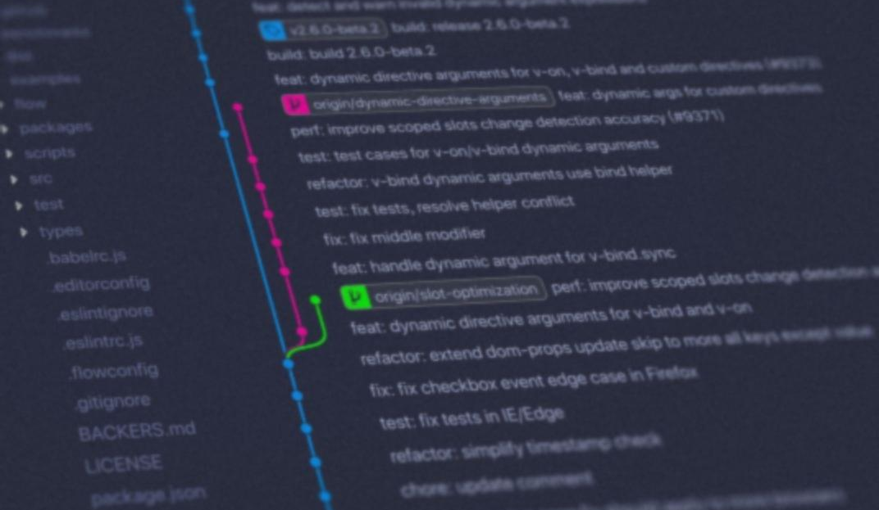




Introduction to Git and GitHub
Speakers:
Susan Ghimire
Panas Tiwari

Slide 2

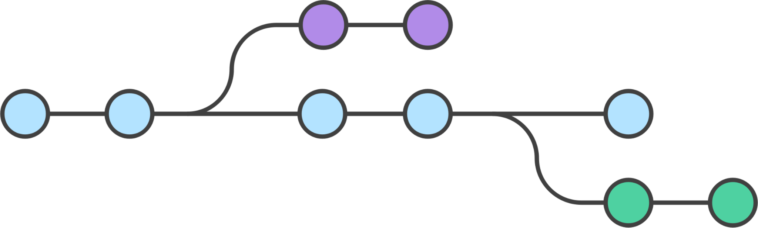

Table of contents
1. Forking
2. Branching
3. Pull Request
3

Slide 3

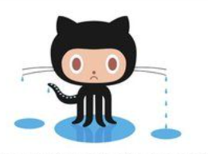
Table of contents
4. Merge Conflicts
5. GitHub issues and ways of assigning them

Slide 4
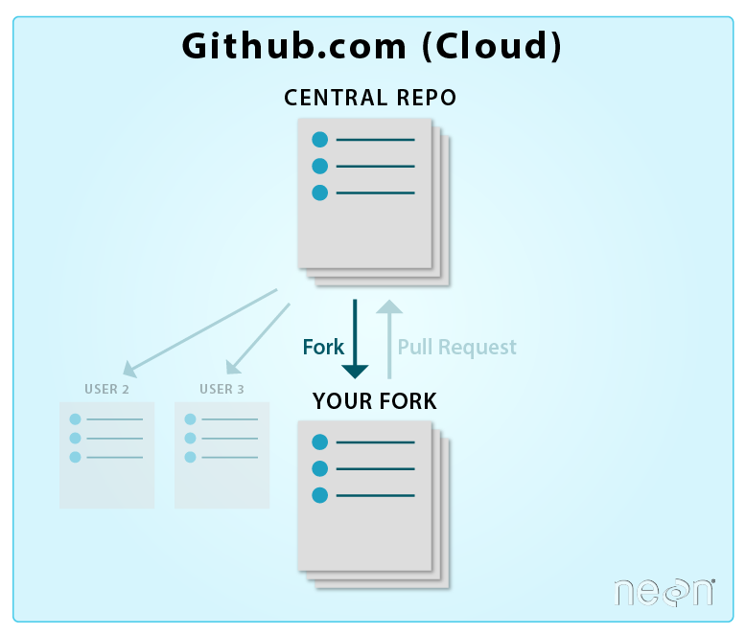
What is Forking?
Forking is a git clone operation executed on a server copy of a projects repo.
Forking creates your own copy of a repository in a remote location (for example, GitHub).
Your own copy means that you will be able to contribute changes to your copy of the repository without affecting the original repository.

Slide 5
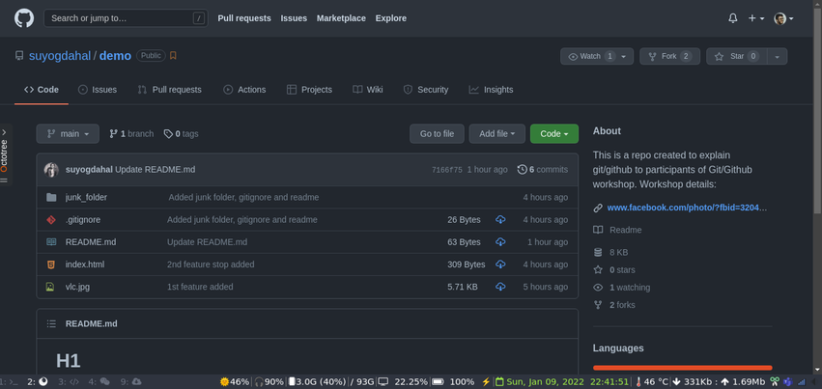
Step 1 : Fork from main repository

Slide 6
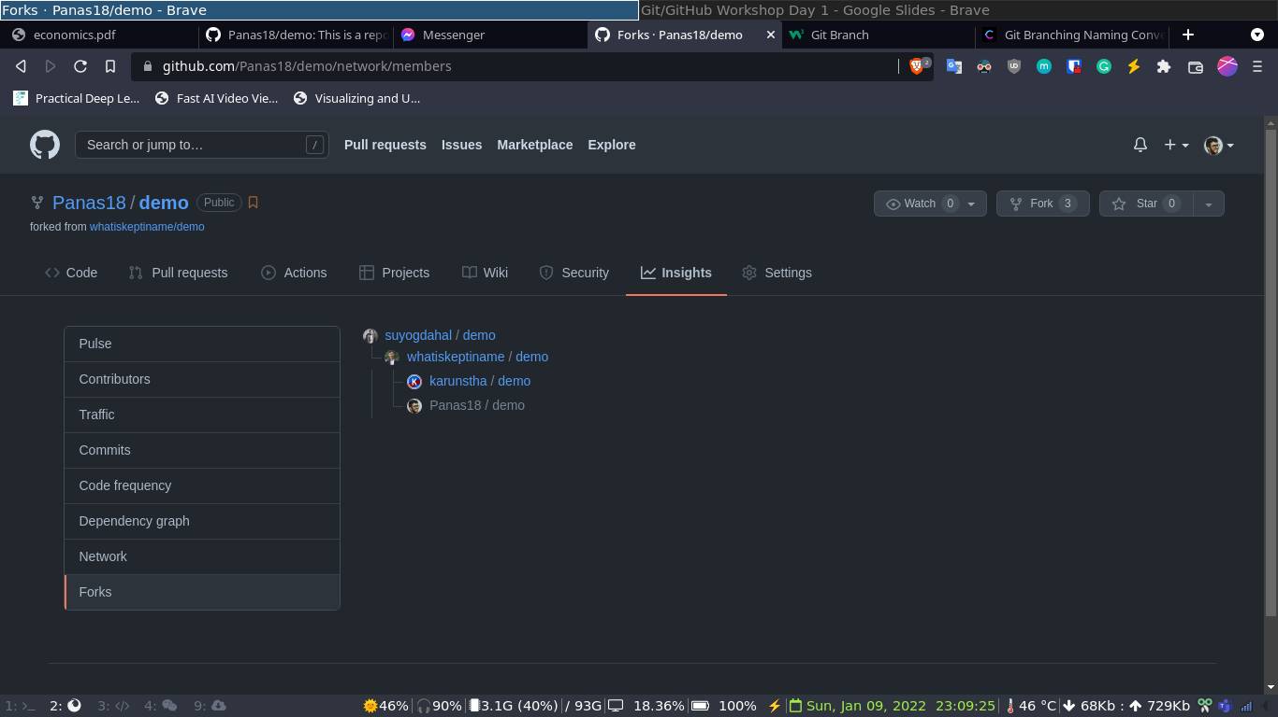
Step 2 : Fork from team leader

Slide 7
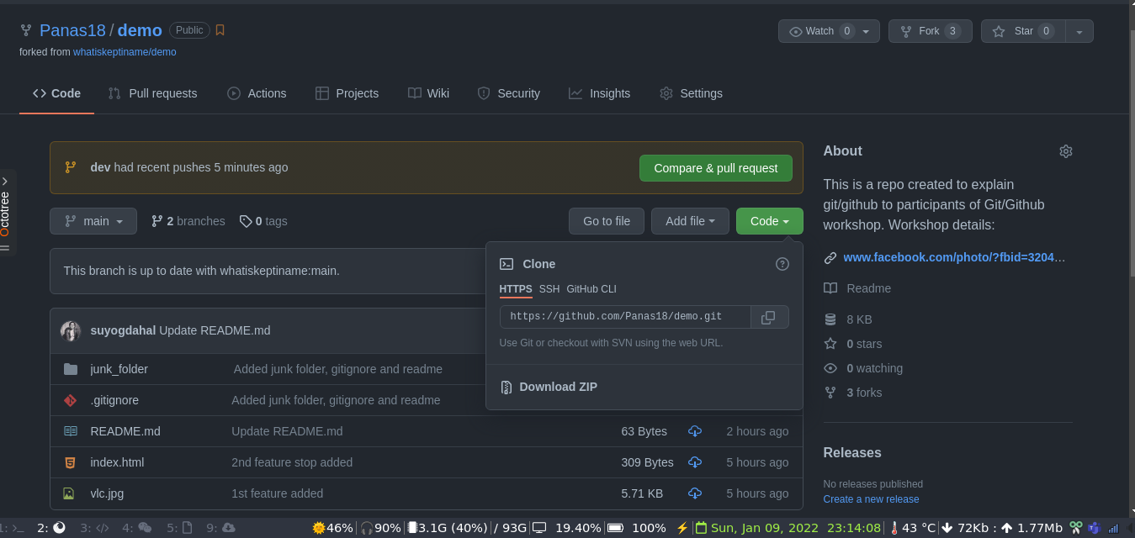
Step 3 : Git Clone

Slide 8
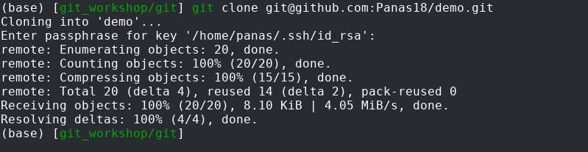
$ git clone <link>
This command is used to point to an existing repo and make a clone or copy of that repo at in a new directory, at another location.

Slide 9
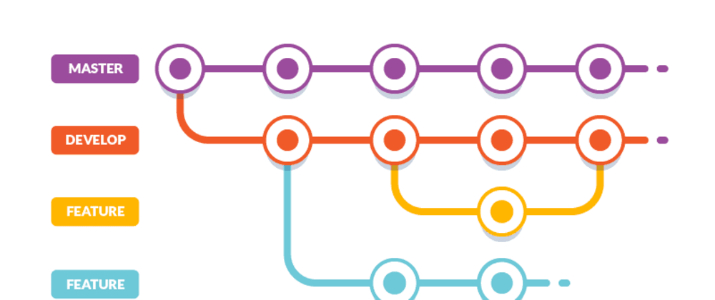
What is Git branching?
Branching is the practice of creating copies of programs or objects in development to work in parallel versions, retaining the original and working on the branch or making different changes to each.
A branch is essentially is a unique set of code changes with a unique name
Edit code on new branch without impacting the main branch.
Common examples: Stable, Testing etc

Slide 10
Step 4 : Create New Branch

Slide 11
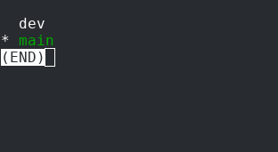
$ git branch
This command is used to to list all the branches

Slide 12
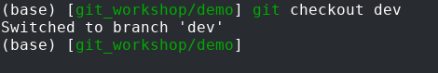
Step 5 : Change Branch

Slide 13
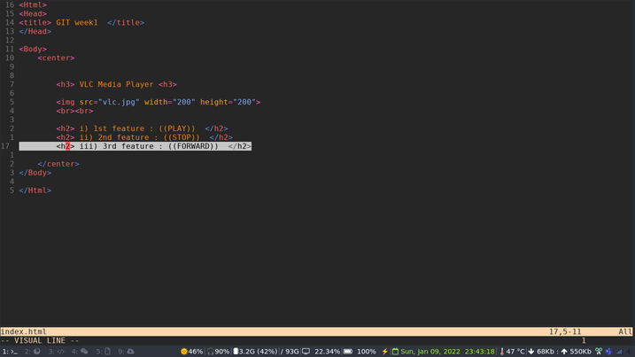
Step 6 : Add features inside new branch

Slide 14
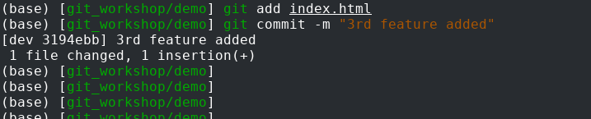
Step 7 : Commit changes

Slide 15
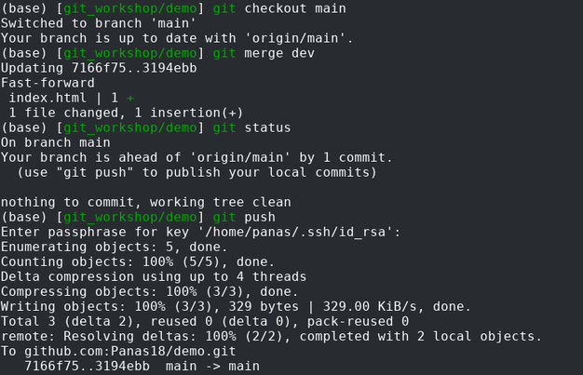
Step 8 : Git merge

Slide 16


Any Questions??

Slide 17
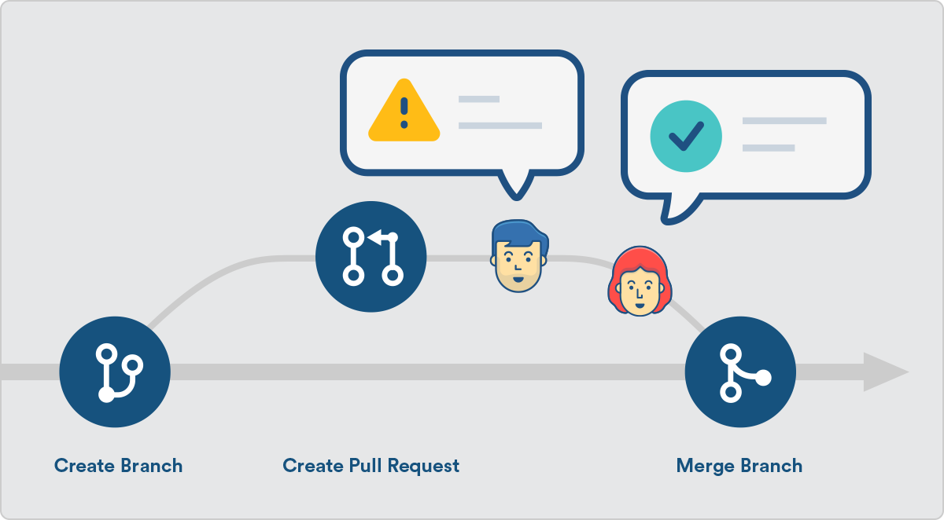
What is Pull Request?
A pull request is a method of submitting contributions to an open development project.
A pull request occurs when a developer asks for changes committed to an external repository to be considered for inclusion in a project's main repository.

Slide 18
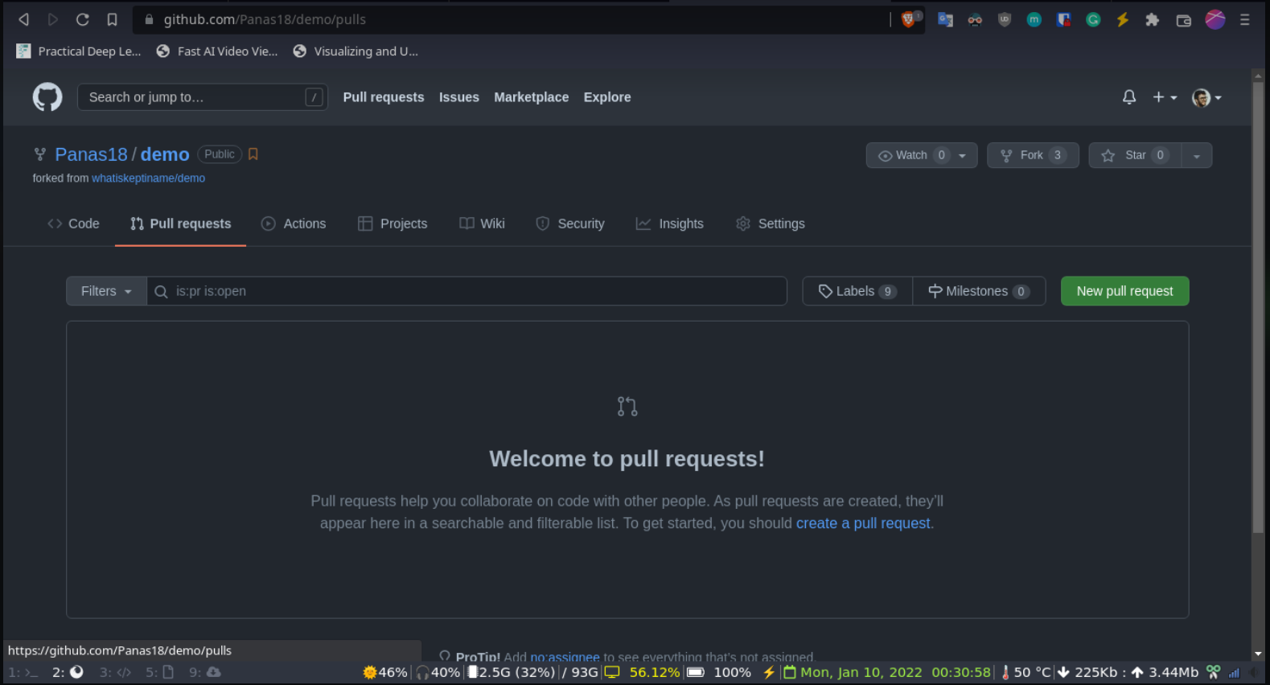
Creating pull request

Slide 19
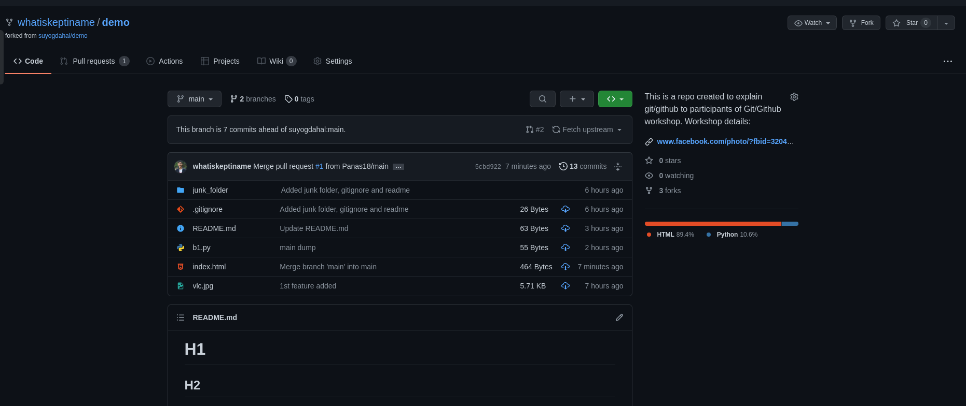

Slide 20
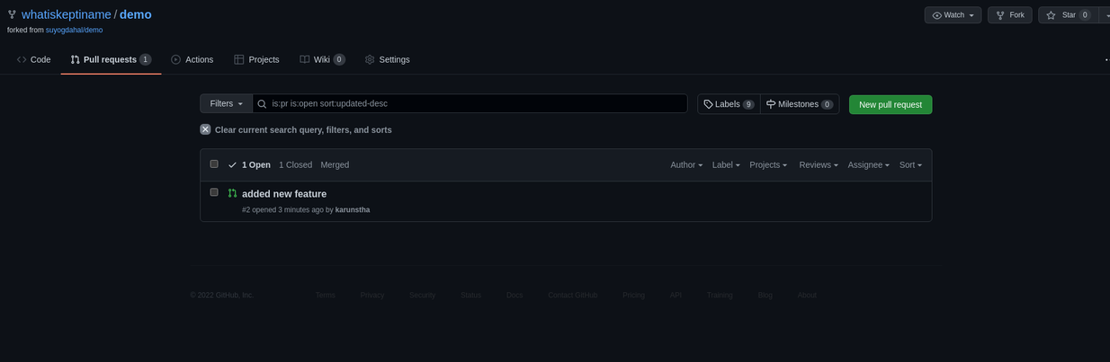

Slide 21
Merge Conflict
A merge conflict is an event that occurs when Git is unable to automatically resolve differences in code between two commits.
In real world merge conflict happens because of following reasons:
Same line of code is changed in two branches.
A given file is changed in one branch and deleted in another branch
Same file is added twice in two different branch but the content of the file is different

Slide 22
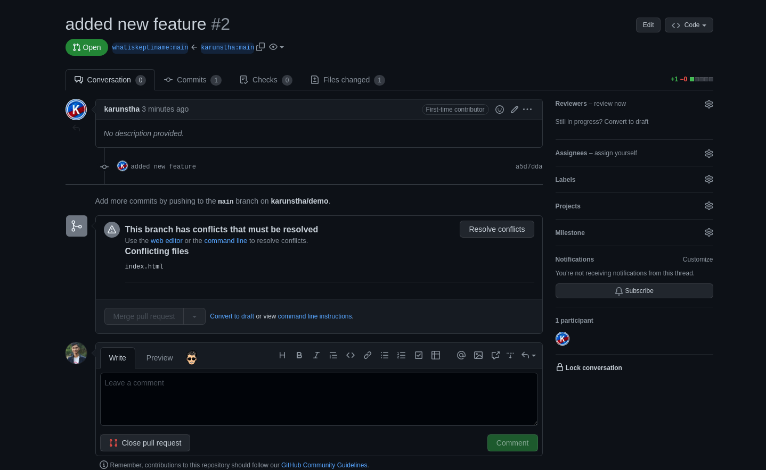

Slide 23
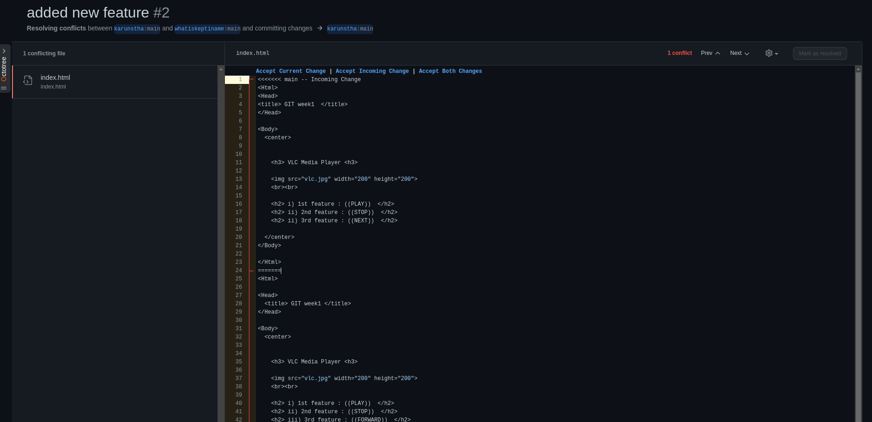

Slide 24
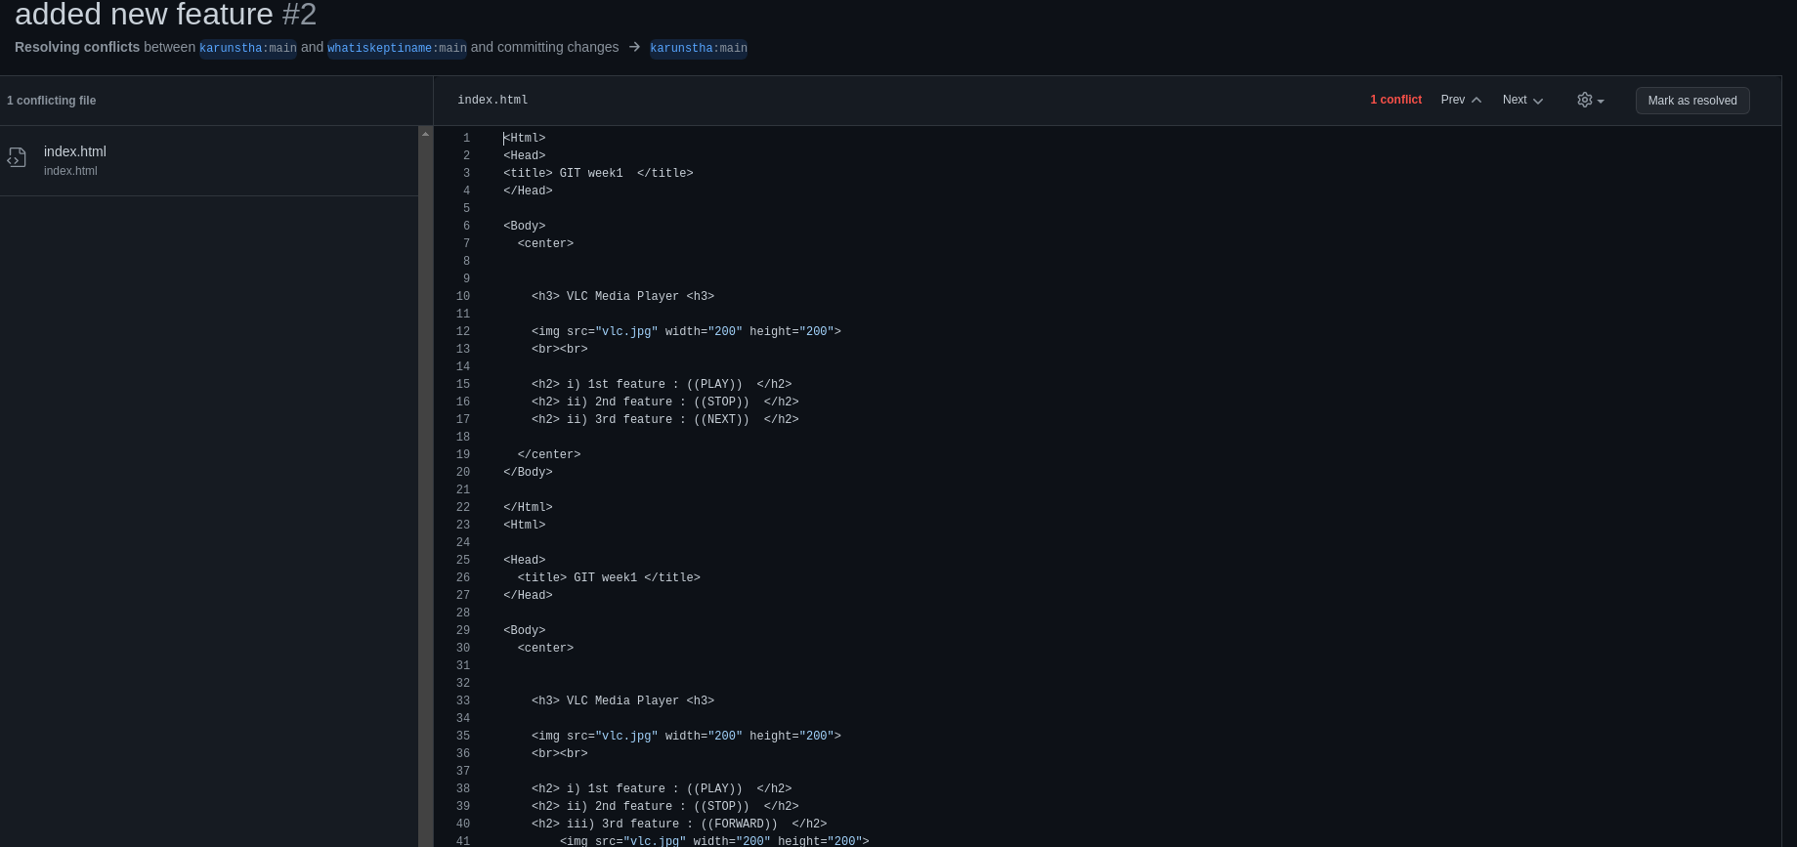

Slide 25
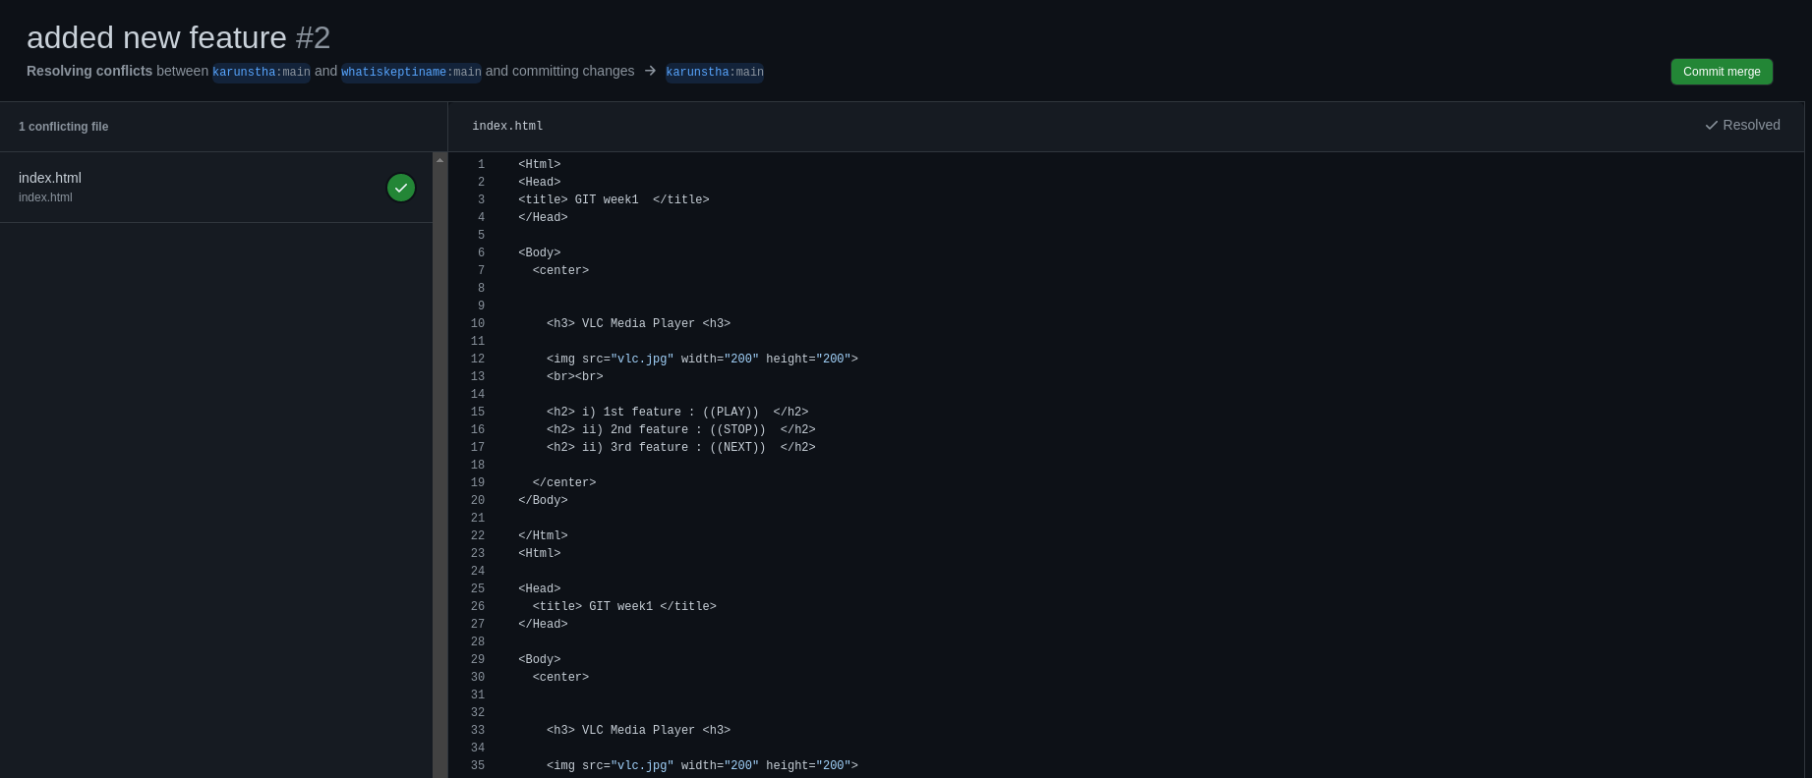

Slide 26
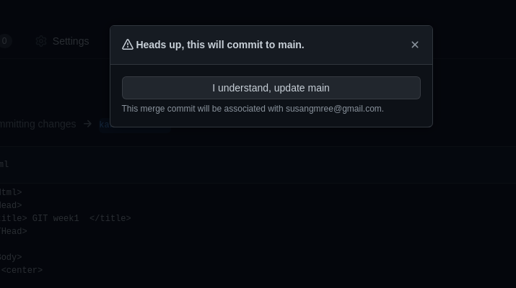

Slide 27
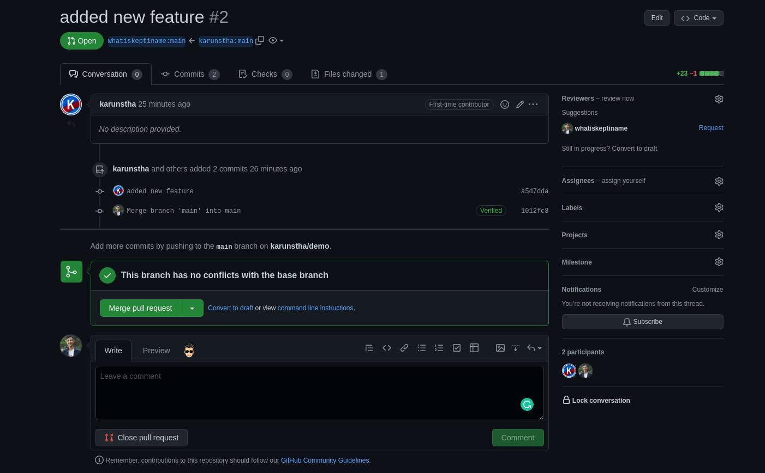

Slide 28
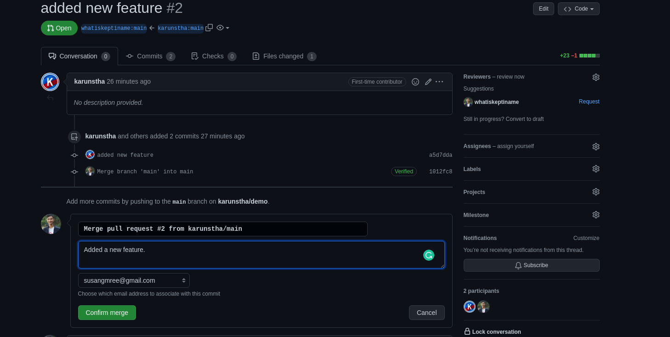

Slide 29
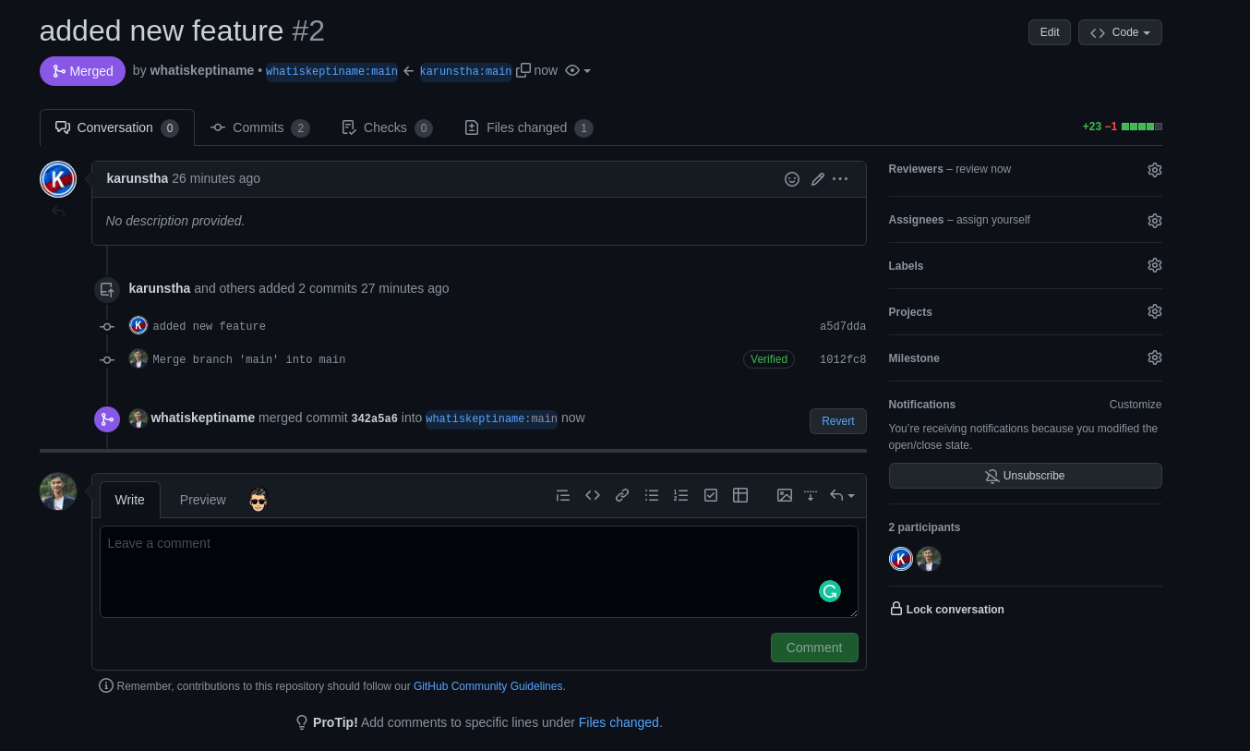

Slide 30


Slide 31
GitHub Issues and ways of assigning them
GitHub Issues is a tracking tool that is integrated with your GitHub repository.
Issues let you track your work on GitHub, where development happens.
Github issues is used to:
Track ideas
Feedback
Assign task
Report bugs

Slide 32
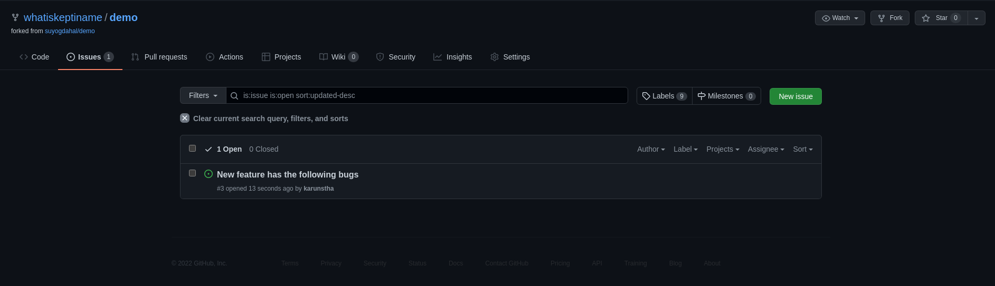

Slide 33
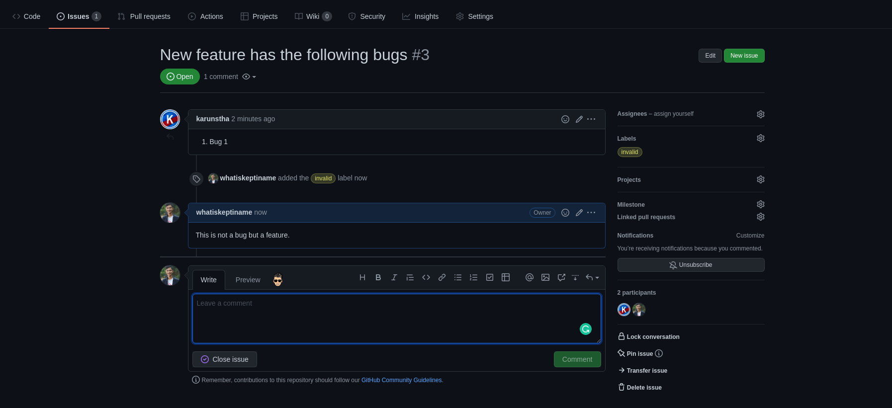

Slide 34


Slide 35

Assignment
If you’re facing any difficulties:
Contact us at:
Facebook: Kec Robotics Club Kec I.T. Club
Mail: rbtkec@gmail.com
kecktm.it.club@gmail.com

Slide 36
